Slide 1
Boosting Algorithms
A boosting algorithm is an ensemble learning technique that combines multiple weak learners (models that perform slightly better than random) to create a strong learner by training models sequentially, with each model focusing on correcting the errors made by the previous ones.
3 major boosting algorithms
Ada Boosting - Adaptive boosting
XG Boosting - Gradient boosting
Lg boosting - Extreme Gradient boosting

Slide 2


Slide 3

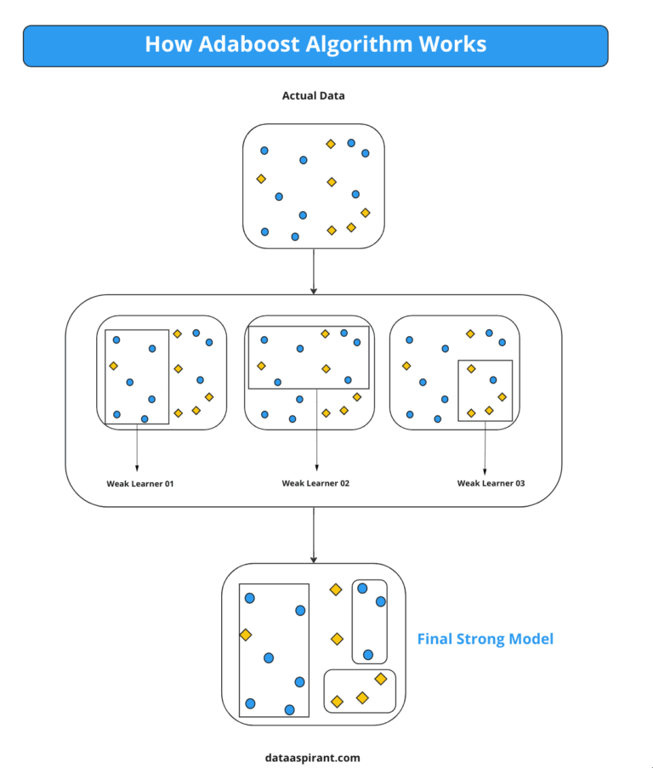
What is Ada Boosting Algorithm ?​

Slide 4
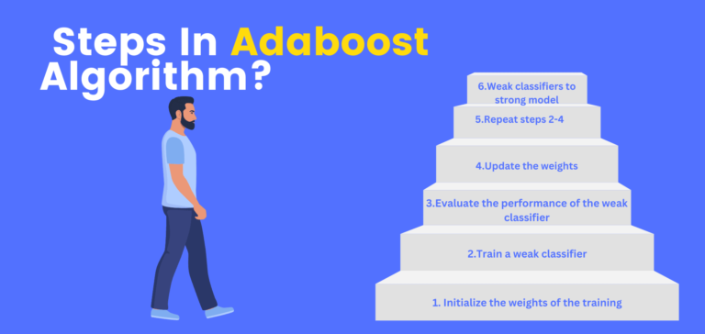

Slide 5
Best practice for Ada Boost Algorithm
Feature Selection
Choosing the Right Weak Learner
Avoid Overfitting Using Cross-Validation
Dealing with Class Imbalance

Slide 6
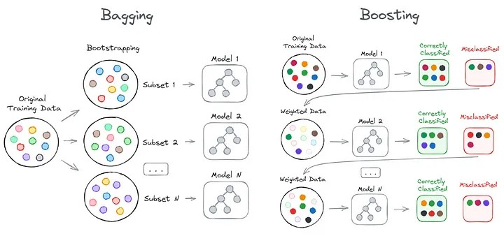
Bagging VS Boosting

Slide 7
Application of Ada Boosting
Image and Face Recognition
Financial Forecasting
Healthcare
Text & Sentiment Analysis
Marketing & Customer Relationship Management (CRM)

